Slide 1
Linked list II
SESSION 04
Henry Lucky, S.Kom., M.Kom.

Slide 2
LEARNING OUTCOMES
Session 04
The learning outcomes associated with this topic:
LO 1: Explain the concept of data structures and its usage in Computer Science
LO 2: Illustrate any learned data structure and its usage in application
LO 3: Apply data structures using C

Slide 3
LEARNING Objectives
Session 04
At the end of this session, students will be able to:
Understand the concept of Circular Linked List and Double Linked List
Apply the Double Linked List using C

Slide 4
SUBTOPICS
Session 04
Double Linked List
Circular Single Linked List & Double Linked List

Slide 5
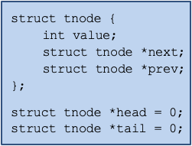
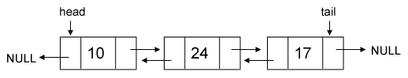
Double linked list
concept
Double/Doubly linked list or two-way linked list is a linked list data structure with two link, one that contain reference to the next data and one that contain reference to the previous data.

Slide 6
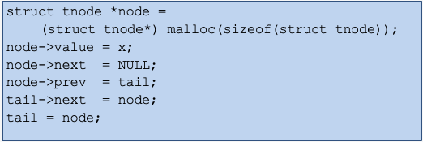
Double linked list
insert
Just like in a single linked list, first we should allocate the new node and assign the value to it, and then we connect the node with the existing linked list.
Supposed we want to append the new node behind the tail.

Slide 7
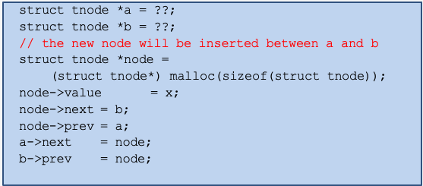
Double linked list
insert
Supposed we want to insert a new node in a certain position (any location between head and tail)

Slide 8
Double linked list
delete
There are 4 conditions we should pay attention when deleting:
The node to be deleted is the only node in linked list.
The node to be deleted is head.
The node to be deleted is tail.
The node to be deleted is not head or tail.

Slide 9
Double linked list
delete
The node to be deleted is the only node in linked list.
free(head);
head = NULL;
tail = NULL;
The node to be deleted is head.
head = head->next;
free(head->prev);
head->prev = NULL;

Slide 10
Double linked list
delete
The node to be deleted is tail.
tail = tail->prev;
free(tail->next);
tail->next = NULL;

Slide 11
Double linked list
delete
The node to be deleted is not head or tail.
struct tnode *curr = head;
while ( curr->next->value != x ) curr = curr->next;
struct tnode *a = curr;
struct tnode *del = curr->next;
struct tnode *b = curr->next->next;
a->next = b;
b->prev = a;
free(del);

Slide 12
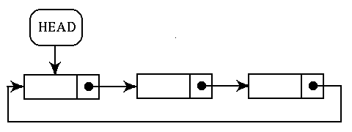
Circular single linked list and double linked list
Circular single linked list
In circular, last node contains a pointer to the first node
We can have a circular singly linked list as well as a circular doubly linked list.
There is no storing of NULL values in the list

Slide 13
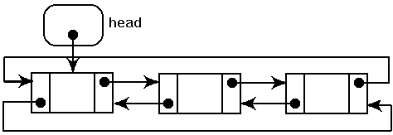
Circular single linked list and double linked list
Circular double linked list
It is similar with circular single linked list, but total pointer in each node here is 2 (two) pointers.

Slide 14
References
S. Sridhar. 2015. Design and Analysis of Algorithms. Oxford University Press. New Delhi. ISBN: 9780198093695. Chapter 5
Reema Thareja. 2014. Data structures using C. Oxford University Press. New Delhi. ISBN:9780198099307. Chapter 6
Thomas H. Cormen, Charles E. Leiserson, Ronald L. Rivest, & Clifford Stein. (2022). Introduction to Algorithms. 04. The MIT Press. London. ISBN: 9780262046305. Chapter 10.
Doubly Linked List, https://visualgo.net/en/list?slide=6

